Slide 1
Natural Duty Theory
Introduction to Political Theory
Semester 2 Week 5 Lecture
Dr. Billy Christmas

Slide 2
Political obligation: natural, not acquired

Slide 3
Conditional arguments for authority: Consent theory Obligation is acquired through consent Obligation is conditional upon consent Fair play theory Obligation is acquired through receipt of presumptive, non excludable benefits, in accordance with fairness Obligation is conditional upon a fair allocation of presumptive, non-excludable, benefits Unconditional arguments for authority: Natural duty theory Obligation is natural; nothing needs to happen to trigger it Obligation is unconditional (or, it is conditional only on you being human)

Slide 4
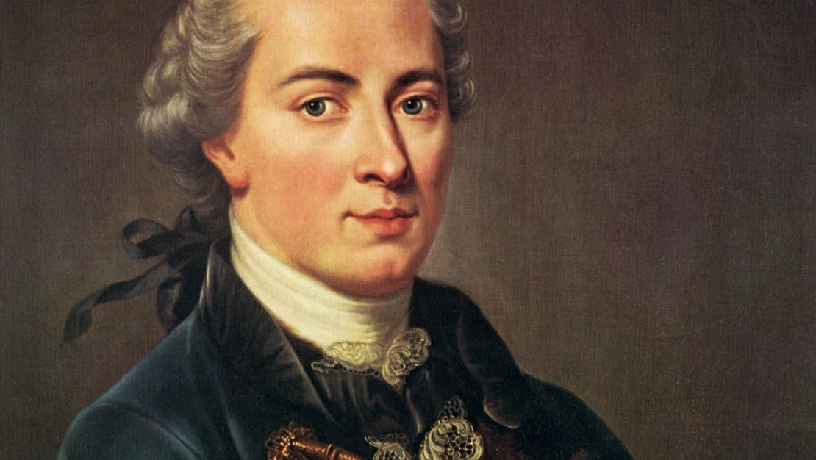
IMMANUEL KANT
THE INNATE RIGHT TO EQUAL FREEDOM

Slide 5
Freedom (independence from being constrained by another’s choice), insofar as it can coexist with the freedom of every other in accordance with a universal law, is the only original right belonging to every man by virtue of his humanity. (The Metaphysics of Morals §6.238)

Slide 6
External freedom: property ownership and freedom of contract

Slide 7
Three Defects in the State of Nature mean Rights to External Freedom cannot be actualised

Slide 8
Rights to external freedom must and yet cannot (in a state of nature) be: 1. Acquired 2. Enforced 3. Applied

Slide 9
Acquisition Unilateral acquisition of rights involves imposing duties on all others Thus contravening their right to freedom (as independence from the choices of others)

Slide 10
Enforcement Without enforcement of rights, we are vulnerable, and at liberty to take pre-emptive force As is everyone one else Hobbesian state of insecurity → no right to external freedom

Slide 11
Application Abstract right to freedom must be applied in some particular concrete way (many possible realisations) Unilateral interpretation and application involves imposition of private judgement upon others(in form of acquisition or enforcement) This contravening their right to freedom (as independence from the choices of others)

Slide 12
Conceptual problems, not merely empirical contingencies Arise due to: Our embodiment Scarcity of space we share Action can only proceed if not physically frustrated The nature of rights (correlativity)

Slide 13
Natural Duty to: Exit the State of Nature Establish and Obey a Civil Government

Slide 14
Unilateral Will vs. Omnilateral Will

Slide 15
In the properly constituted state, property and other forms of acquired right are institutionalized so that the laws under which individuals make their claims are no longer the expression of anyone’s unilateral will. Nor are the application and enforcement of those laws. They are instead the expression of a public, “omnilateral” will. – Thomas Sinclair, “The Power of Public Positions: Official Roles in Kantian Legitimacy,” Oxford Studies in Political Philosophy, 4 (2018), p. 35

Slide 16
Unlike private actors, the state as a public agency can enforce rights without undermining the relation of reciprocal independence in which its subject stand. Only states, with their authoritative legal system and monopoly of public force, have the capacity to provide the unitary jurisdiction and assurance that individuals require. – Anna stilz, “Nations, States, and Territory,” Ethics, 121 (2011) p. 581

Slide 17
The state is a morally significant entity by virtue of the tasks it takes on, the spirit in which it addresses them, and the resources it brings to those tasks. If it acts as though it embodies the united will of the whole people, operating through the medium of general laws, and deploying effective and coordinated force to secure an environment governed by those laws, then it is legitimate and the people must submit to it. Jeremy Waldron, “Kant’s Theory of the State,” in Immanuel Kant, Toward Perpetual Peace and Other Writings on Politics, Peace, and History, ed. P. Kleingeld (Yale University Press, 2006), p. 187

Slide 18
General rules that are not the product of any unilateral will Legislature → Acquisition Executive → Enforcement Judiciary → Application

Slide 19
CHALLENGES

Slide 20
Too Strong? Is it a conceptual truth that rights cannot be secured in a state of nature? Seems like an empirical claim Social conventions and norms could stabilise rights

Slide 21
Double Counting? How can processes that create rights violate rights?

Slide 22
Particularity Problem Which state am I obligated to?

Slide 23
Answering Particularity Problem The need for rights arises among those who unavoidably encounter one another in space Those who share territory therefore need to share a state Therefore, you are obligated to the state that happens to govern the territory you occupy NB: territorial boundaries are creations of state, they do not pre-exist them. Those that live near borders interact with those of other territories

Slide 24
The Challenge of Globalisation We now cooperate globally without a global state Either: NDT demands a global state, or globalisation disproves the NDT

Slide 25
Thank you!

